Slide 1


YR
Early Years Foundations Stage 4-5
Meet the teacher
Wednesday 10th September 2025

Slide 2
Our Vision Statement
We nurture a vibrant school community where every child, guided by God's grace and love, discovers and harnesses their unique gifts and talents. We empower each student to flourish, developing their character and education so that they may contribute positively to society using our values of kindness, creativity, respect and perseverance.

Slide 3

‘Having gifts that differ according to the grace given to us – let us use them’
Romans 12:6

Slide 4


Slide 5
Adults working in our classroom
Mrs Budzowska-White (Class Teacher)
Mrs Youngs (Teaching Assistant)
Mrs Bennett – (HLTA) (on Fridays and PPA cover)
Mrs Hussain – Volunteer (Tuesday & Thursday/Friday)

Slide 6
Information
All information will be updated onto the class page on the school website: https://www.stpaulinus.apat.org.uk
Medium term planning (for each half term)
National Curriculum Early Learning Goals for the end of EYFS
Phonics support
First 100 HFW list

Slide 7
7 Key Areas within EYFS
Personal, Social and Emotional Development
Communication and Language
Physical Development
Maths
Literacy
Understanding the World
Expressive Arts and Design

Slide 8
A typical day in Reception…
8.40am – Reading for pleasure/dough disco/letter or number formation on whiteboards/wake up, shake up/readers
8.55am – Register, Morning Prayer song, Wake up shake up exercise
9.05am – 9.50am – ELS Phonics (and free flow)
9.50am – 10.20am - Maths
10.20am – 10.40am - Fruit and Milk
10.40am – 11.40am – Literacy Structured Story with Puppet Fantastic (and free flow)
11.40am – Songs/Toilets/Get ready for lunch
11.50am – 1.00pm – Lunchtime
1pm – Register, dough disco
1 – 3.00pm – wider curriculum UTW/EAD/RE/PSHE input (and free flow)
3pm – Tidy up/get ready for home
3.15pm – class story
3.25pm - end of day
In addition:
individual/group reading, writing and maths
PE,
Singing
Twigs and Trees,
My Happy Mind wellbeing sessions,
IT
Your child may come home tired!

Slide 9
Tapestry and recording of learning
A way for us to show you snippets of our learning in school (may be a whole class entry or an entry of your individual child)
Once we have received all permission slips, we will launch the app and you will receive login details via email
Entries will be to showcase children’s regular learning and WOW moments.
Each child will have their own Maths and Literacy books to record their learning.
Children will be weekly busy creating their art and design projects. Some of it will go home, other pieces will be used some for decorations of the classroom and the corridors.

Slide 10
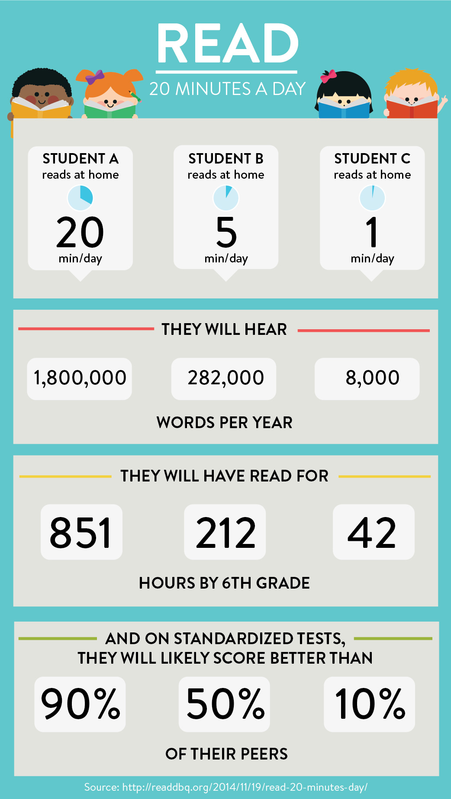
Information –
Reading homework
“Reading for pleasure is more likely to determine whether a child does well at school than their social or economic background”
https://www.pearson.com/uk/learners/primary-parents/learn-at-home/help-your-child-to-enjoy-reading/why-is-reading-so-important.html
The guide for parents is also on the class page on the school website.

Slide 11
Information – Reading homework
Children are expected to read at home and have their reading recorded in their diaries at least 4 times a week.
Monday to Thursday – the children will learn a new phonics sound each day.
Thursday – the children will be sent home with an ELS reading book that uses the sounds that have been taught that week.
The ELS reading book is to be read four times (to build on word recognition, fluency and intonation).
We will change the ELS reading book every Thursday, so please ensure it is in your child’s book bag.If it is not returned, we cannot give your child a new book until it is brought back into school.
Please write in the date, the book title, your signature or comment.
Please try and find the time to listen to your child read every day. It will make such a big difference to their development.

Slide 12
Information –
Reading for pleasure
Your child will also be able to take home a library book of their choice. This can be exchanged at any point and it will be the responsibility of the child to change their library book (we will give reminders).
We will also have books from our old phonics scheme available for the children to take home if they wish to further practise their blending.

Slide 13
Information –
Homework
A homework menu will be available on the class page and will be send home.
It is optional.
If your child does complete any of the pieces of homework suggested, they are welcome to bring them into school at any point (please label with their name, the date and ‘homework’).
At the end of the half term, your child will be celebrated in assembly and they have the option to show/explain what they have done to the rest of the school.

Slide 14
Information –
Harder to Read and Spell (HRS) Words
HRS words will be sent home after half-term in Autumn 2.
Your child will receive five words from the 100 high-frequency-word list that they will be expected to read for the following week.
For every word they read correctly, they will be given a new word to learn for the following week.
Once they have mastered reading the first 100 H-F-W, we will ask children to write them out correctly.
Your child will be tested on their HRS words every Monday. Please ensure their HRS book is in their book bag every Monday morning.

Slide 15
Days to remember…
Monday
HRS words book due in (from Autumn 2 onwards)
Monday & Thursday – PE
PE Kit to be worn to school. Please have long hair tied up and all earrings removed.
Wednesday – Twigs and Trees
Children to come to school in their usual uniform. Children will change into their wellies (and puddle suits) before we go into the forest.
Thursday – New reading book
Children must return their old reading book before they will be allowed to get a new one. Please write the date, title and comment in your child’s reading record.
Every weekday – Library books
Your child can change their library book as often as they like, as long as they return their old book first.

Slide 16
Information –
Attendance
Please ensure that children are in school on time every day.
The school gates are open from 8.40am to drop your child into school.
Our day begins at 8:55am, we finish at 3:25pm.
Every effort should be made to make routine appointments outside of the school day.

Slide 17
Information –
Attendance
If your child is unwell, inform the school office by 8:30am.
If a child is absent or sent home due to vomiting and/or diarrhoea then they should not return to school for the next 48 hours after the last time that the child is sick.
Please see the Attendance policy on our website for further details.

Slide 18
Additional information
Please make sure all school uniform is named so that it can easily be returned to you.
Your child may come home a bit messier than how they came to school that morning… we embrace mud, sand and water play (as well as playdough, occasional slime, shaving foam and glitter), but we do provide aprons.
Celebration Assemblies will take place on Fridays (from Autumn 2) - please feel free to bring in any certificates or medals from achievements outside of school

Slide 19
How to contact us:
Urgent messages should always come through the office.
If you need to speak to me, I am available at the end of the day (but please let me dismiss the remaining children to their parents first).
Alternatively, you can send an email –
reception@st-paulinus.bexley.sch.uk
I look forward to working with all of you to fully support your children.
Any questions???

